Slide 1
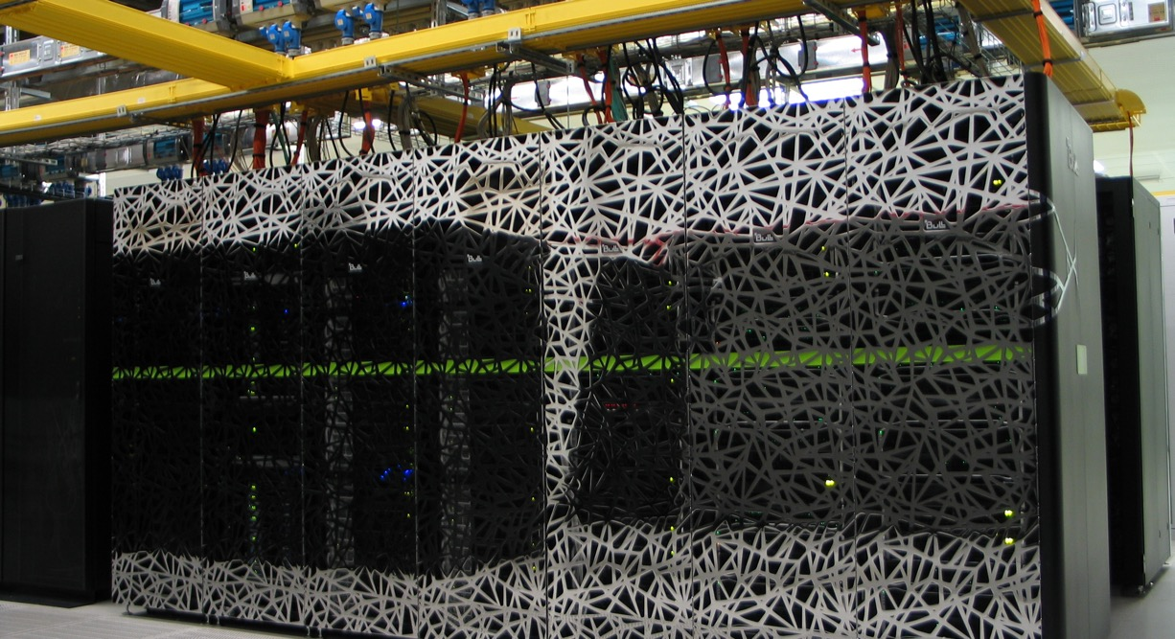
EasyBuild & EESSI @ SURF
Caspar van Leeuwen
High Performance Machine Learning Consultant
Wed 26 Mar 2025

Slide 2
SURF
IT Cooperative of Dutch Education and Research
Computing (HPC, HTC, grid, cloud)
Storage & Data management (object store, tape, PID)
Networking
…

Slide 3
Content
The past
The present
The future

Slide 4
The past
November 2016: EasyBuild 3.0.0 released with RPATH support
Mid 2017: first (publicly available) installations @ SURF through EasyBuild
Start 2019: EasyBuild becomes the default installation method. Manual installation only by rare exception!
Initially build everything with foss & intel toolchains
Since Snellius (2021): foss-only
More build issues with intel, too time consuming for little benefit

Slide 5
The present: Snellius
General-purpose HPC system
Phase 1 (Q3 2021, Q4 2022)
600 AMD Rome 7H12 (zen2) CPU nodes
72 Intel Ice Lake + A100 GPU nodes
Phase 2 (Q3 2023)
800 AMD Genoa 9654 (zen4) CPU nodes
Phase 3 (Q2 2024)
88 AMD Genoa 9334 (zen4) + H100 GPU nodes
Total: 230k CPU cores, 640 GPUs, 38 PFLOPS

Slide 6
Variant symlink setup
Architecture-specific symlink: /sw/arch
Points to an architecture-specific prefix:
$ ls -al /sw/arch
lrwxrwxrwx 1 root root 32 Mar 3 12:12 /sw/arch -> /gpfs/admin/hpc/sw/arch/AMD-ZEN2
$ ls -al /gpfs/admin/_hpc/sw/arch
…
drwxrwxr-x 6 jenkins jenkins 8192 Dec 19 15:07 AMD-ZEN2
drwxrwxr-x 6 jenkins jenkins 4096 Oct 3 13:17 AMD-ZEN4
drwxrwxr-x 5 jenkins jenkins 4096 Oct 3 13:09 AMD-ZEN4-H100
drwxrwxr-x 6 jenkins jenkins 4096 Oct 3 13:15 INTEL-AVX512

Slide 7
Variant symlink setup
We don’t export submission environment in batch jobs, but even if you do, it resolves to the correct executable:
int1 $ module load GROMACS/2024.3-foss-2024a
int1 $ which gmx_mpi
/sw/arch/RHEL9/EB_production/2024/software/GROMACS/2024.3-foss-2024a/bin/gmx_mpi
int1 $ realpath $(which gmx_mpi)
/gpfs/admin/_hpc/sw/arch/AMD-ZEN2/RHEL9/EB_production/2024/software/GROMACS/2024.3-foss-2024a/bin/gmx_mpi
int1 $ srun -p genoa realpath $(which gmx_mpi)
/gpfs/admin/_hpc/sw/arch/AMD-ZEN4/RHEL9/EB_production/2024/software/GROMACS/2024.3-foss-2024a/bin/gmx_mpi

Slide 8
How we manage 4 optimizations
Site-specific customizations are done through hooks, rather than customizing EasyConfigs / EasyBlocks
Semi-automated builds by Jenkins, based on a buildlist, e.g.
### Basic Compilers ####
GCCcore-13.3.0.eb
intel-compilers-2024.2.0.eb --accept-eula-for=Intel-oneAPI --from-pr=20903
Clang-18.1.8-GCCcore-13.3.0.eb --from-pr=21117
##### MPI Libraries ###
OpenMPI-5.0.3-GCC-13.3.0.eb --hooks=/sw/eb/easyconfigs-surf/hooks/mpi_hook.py --include-easyblocks=/sw/eb/easyblocks-surf/openmpi.py --from-commit=a6c22ba28a69f0c42724a72243f92aa27fc6459c
impi-2021.13.0-intel-compilers-2024.2.0.eb --accept-eula-for=Intel-oneAPI --hooks=/sw/eb/easyconfigs-surf/hooks/mpi_hook.py --from-pr=20919
MPICH-4.2.2-GCC-13.3.0.eb --from-pr=21442 --hooks=/sw/eb/easyconfigs-surf/hooks/mpi_hook.py
mpi4py-4.0.1-gompi-2024a.eb --from-pr=21662
##### Libraries ####
pybind11-2.12.0-GCC-13.3.0.eb --from-pr=20829
libcint-6.1.2-gfbf-2024a.eb --from-pr=21545
libpng-1.6.43-GCCcore-13.3.0.eb
libxml2-2.12.7-GCCcore-13.3.0.eb --hook=/sw/eb/easyconfigs-surf/hooks/libxml2_hook.py

Slide 9
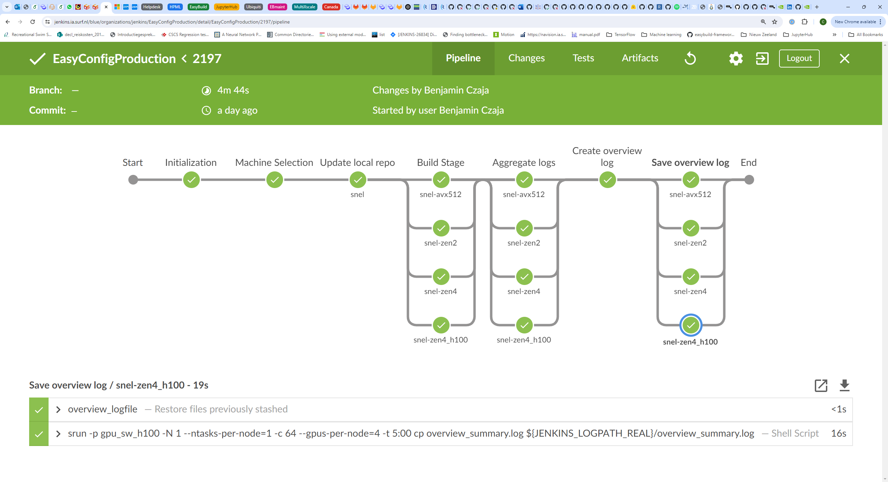

Slide 10
Managing OS upgrades
OS upgrades have caused issues in the past, requiring rebuilds
One solution was to pro-actively just rebuild the entire stack, on the new OS
OS-specific prefix allows building new stack while keeping old stack
Update MODULEPATH to new prefix after upgrade to ‘flip the switch’
But: strategy not used anymore on RHEL8 to RHEL9 upgrade
ReFrame tests didn’t signal many issues
There were some issues in the end (e.g. OpenSSL related), but not many, and all handled on the fly after the upgrade
int1 $ realpath $(which gmx_mpi)
/gpfs/admin/_hpc/sw/arch/AMD-ZEN2/RHEL9/EB_production/2024/software/GROMACS/2024.3-foss-2024a/bin/gmx_mpi

Slide 11
User installations
Wrapper eblocalinstall:
EASYBUILD_INSTALLPATH = ∼/.local/easybuild/…
EASYBUILD_OPTARCH = <lowest_common_denominator>

Slide 12
Snellius software policy
We update our software stack once per year. Typically:
based on 202Xa
released around Q3 or Q4
O(400) packages
Only honor sofware installation requests if:
… is versioned
… has an official release within last 2 years
Max. 2 versions per software per year
Though we may allow exceptions (but don’t tell our users ☺)
Currently considering to add 202Xb, but toolchains-only
https://servicedesk.surf.nl/wiki/spaces/WIKI/pages/30660267/Software+policy+Snellius

Slide 13
Snellius software policy
Yearly software stacks available through meta-modules (that set MODULEPATH)
Clear what is still supported
Confronts users with how old things are that they are using…
$ module av
--------------------------- /sw/noarch/environment ----------------------------
2022 2023 2024 EESSI/2023.06
Full support: additional installations + resolve issues with existing installations
Limited support: resolve issues with existing installations
Deprecated: if it still works for you, we won’t stop you from using it…
Older stacks (2020, 2021) are still there if you know where to look (but don’t tell our users ☺)

Slide 14
Software testing
Local set of ReFrame tests
Run periodically through Jenkins
Run before / after maintenance
EESSI test suite¹
Based on ReFrame
Run periodically through cronjob
¹https://www.eessi.io/docs/test-suite/

Slide 15
The future
EasyBuild: share installation recipes
Share some of the software-installation burden with the community
But: potential issues because of differences in OS stack
European Environment for Scientific Software Installations (EESSI)¹: share actual installations
Share more of the software-installation burden with the community
¹https://www.eessi.io/docs/

Slide 16
The future
Main software environment on Snellius based on EESSI
Already the case on SURF Experimental Technologies Platform
Provide site installations (e.g. proprietary software) on top through the EESSI-extend module¹
Initially on local filesystem
Long term, through CVMFS (‘software.surf.nl’) with whitelisting for SURF-internal systems
Build and deployed by eessi-bot²
Webinar, (probably) June 2nd 2025. See: https://gitlab.com/eessi/support/-/issues/135
¹https://www.eessi.io/docs/using_eessi/building_on_eessi/#building-software-on-top-of-eessi-with-easybuild
²https://www.eessi.io/docs/bot/

Slide 17
The future
Integrate / deduplicate local ReFrame test suite & EESSI test suite

Slide 18
The future
Advantages for EESSI-based software environment
More synergy / shared effort with other HPC teams
Less build effort when new system or phase gets deployed
Uniform software stack across SURF systems (Snellius, SURF Research Cloud & Spider cluster)
Better build automation (EESSI build bot instead of Jenkins)
Optimized user-space builds (through EESSI-extend) instead of lowest common denominator

Slide 19
The future
Advantages for EESSI-based software environment
Shared effort in test development for EESSI test suite

Slide 20
The future
Risks & mitigations in adopting EESSI-based software environment
(How) do we provide support on software that we did not build/deploy ourselves?
Active involvement in EESSI to build knowledge & experience
EESSI community can also provide support, and has much more knowledge!
Risk: EESSI disappears / is no longer maintained
‘software.surf.nl’ build on top of EESSI => easy to (re)build full stack
Bigger community = smaller risks

Slide 21
The future
Risks & mitigations in adopting EESSI-based software environment
Risk: EESSI infrastructure (Stratum 0 / 1) is unavailable
Private Stratum 1 hosts full copy of the SW stack (+ better performance!)
Risk: EESSI does not support the hardware architecture I care about
Provide build infrastructure for EESSI

Slide 22
The future
So if it’s EESSI, EESSI, EESSI, is there a future for EasyBuild?
Yes! EasyBuild is a key technology in EESSI facilitating both the builds in the repository as well as the user-local builds!
EESSI may create additional adoption of EasyBuild
Community adopts EESSI (to get easy access to software they care about)
Community wants newer versions => Motivation to dive into EasyBuild
Have seen this in discussions with geosciences & radio-astronomy communities in NL

